Slide 1
Dual-Branch Networks for Predicting Shared Bikes
2022-11-23
Huigyu Yang
Sungkyunkwan University
huigyu@skku.edu

Slide 2
Presentation Outline
Introduction
Model Architecture
Dataset
Experimental Results
Advanced Model
Future Work

Slide 3
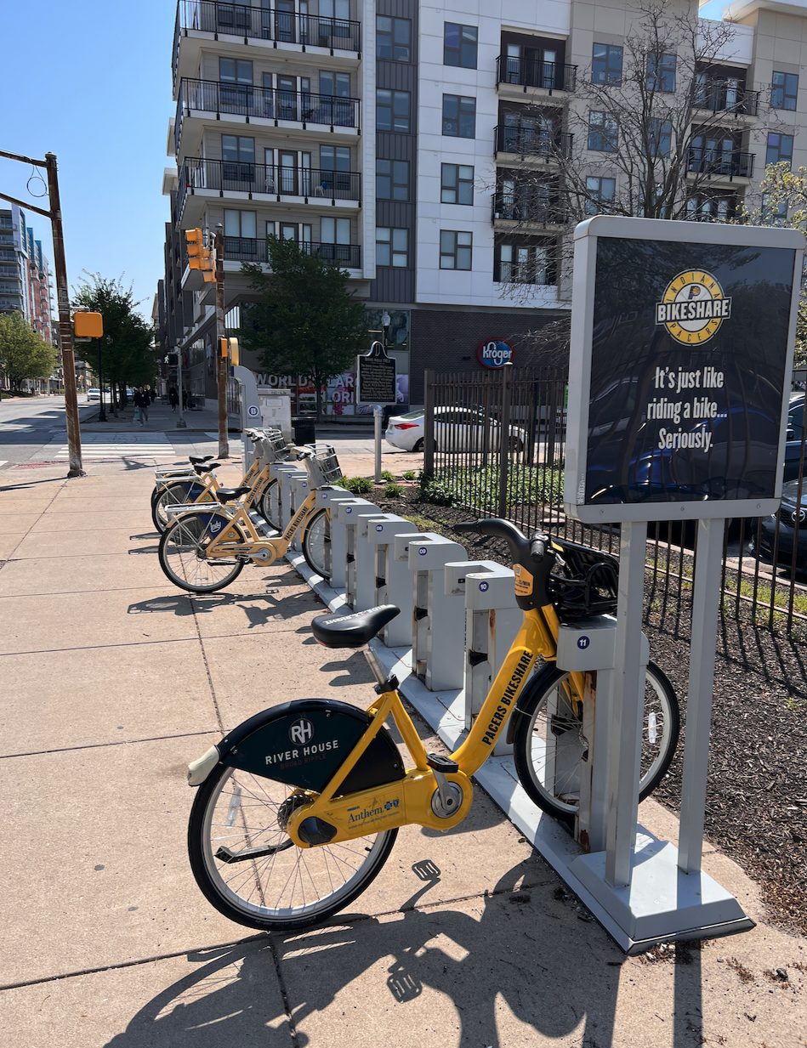
Introduction (1/5)
Bike sharing systems aim to resolve the high-demand problem of public transportations by providing short-term transportation service
The bike sharing systems also can provide efficiencies for user mobility as the users determine the service period according to their demand
The implementations of the ‘sharing’ attribute in two types:
Dock-based bike sharing system
Dockless bike sharing system
A dock refers a designated place and facilities where users can start and end the bike rental services

Slide 4
Introduction (2/5)
The dockless-type systems enable user to start and end the rental service from anywhere whereas the dock-bases systems restrict the service places
The both types of systems have suffered from a demand-supply imbalance problems because of the urban mobility trends
Urban mobility trends can be gathered at certain places such as commercial area or residential area according to the time of day
From this, the number of bikes at the stations (i.e., group of docks) is inevitably imbalanced and this requires service operators to reorganize bikes through stations (i.e., rebalancing)

Slide 5
Introduction (3/5)
The service operators currently reorganize bikes (i.e., rebalancing) in regular time-intervals regardless of actual imbalance
The optimal timing for rebalancing can be obtained by predicting the status of the stations as like as the number of available bikes
Earlier studies for bike sharing systems aims to analysis a relation between user demands and various environmental features such as geological location, transportation, and weathers
Related studies with deep learning approaches propose a prediction model for user demands at each station

Slide 6
Introduction (4/5)
Two limitations from existing studies are as follows:
Station-wise prediction
Next time-step prediction
The demand prediction for individual stations is not sufficient, as the rebalancing process also requires to know which station has lower demand
The optimal timing can be resulted when the model can predict the number of bikes (i.e., indirect) or imbalance events (i.e., direct) in next multiple time-steps

Slide 7
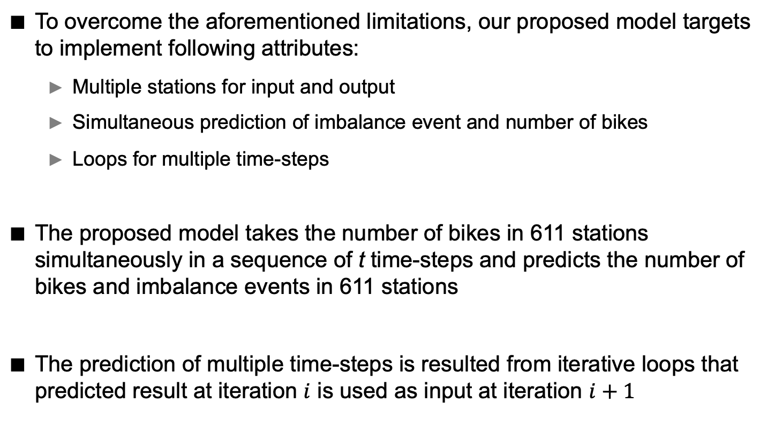
Introduction (5/5)
To overcome the aforementioned limitations, our proposed model targets to implement following attributes:
Multiple stations for input and output
Simultaneous prediction of imbalance event and number of bikes
Loops for multiple time-steps
The proposed model takes the number of bikes in 611 stations simultaneously in a sequence of t time-steps and predicts the number of bikes and imbalance events in 611 stations
The prediction of multiple time-steps is resulted from iterative loops that predicted result at iteration $i$ is used as input at iteration $i+1$

Slide 8
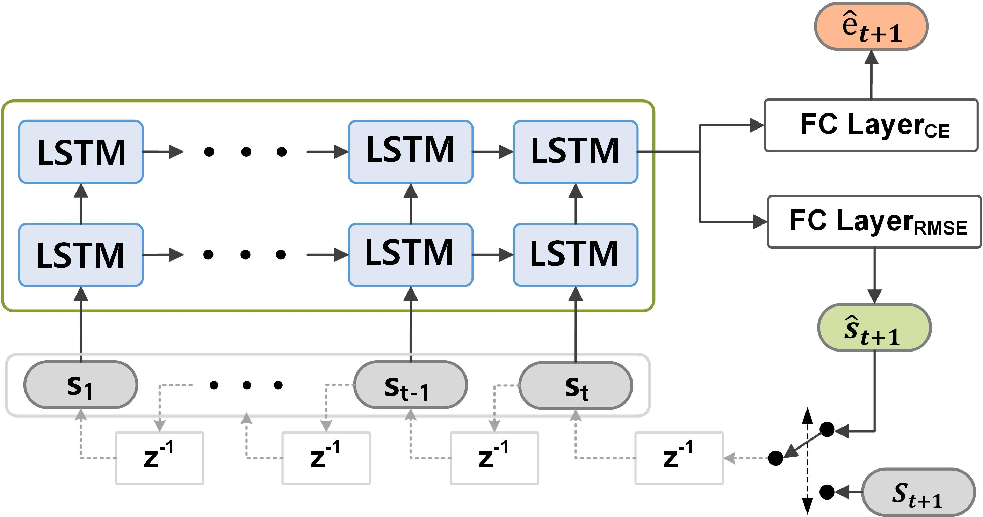
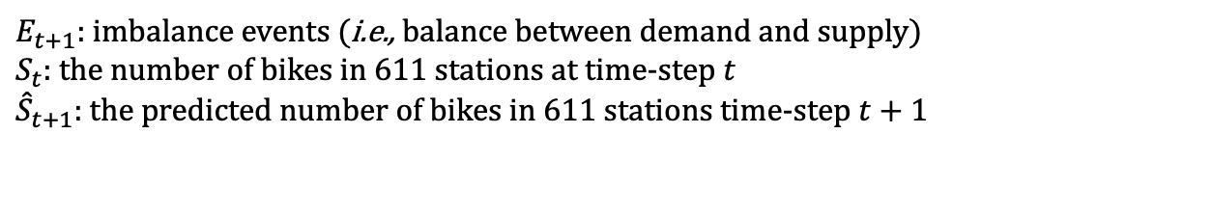
Model Architecture (1/3)
Overall architecture of proposed model
$E_{t+1}$: imbalance events (i.e., balance between demand and supply)
$S_{t}$: the number of bikes in 611 stations at time-step $t$
${\hat{S}}_{t+1}$: the predicted number of bikes in 611 stations time-step $t+1$
CE: crossentropy loss
RMSE: root mean square error loss
$Z^{−1}$refers delay in time-steps (e.g., window shifting)

Slide 9
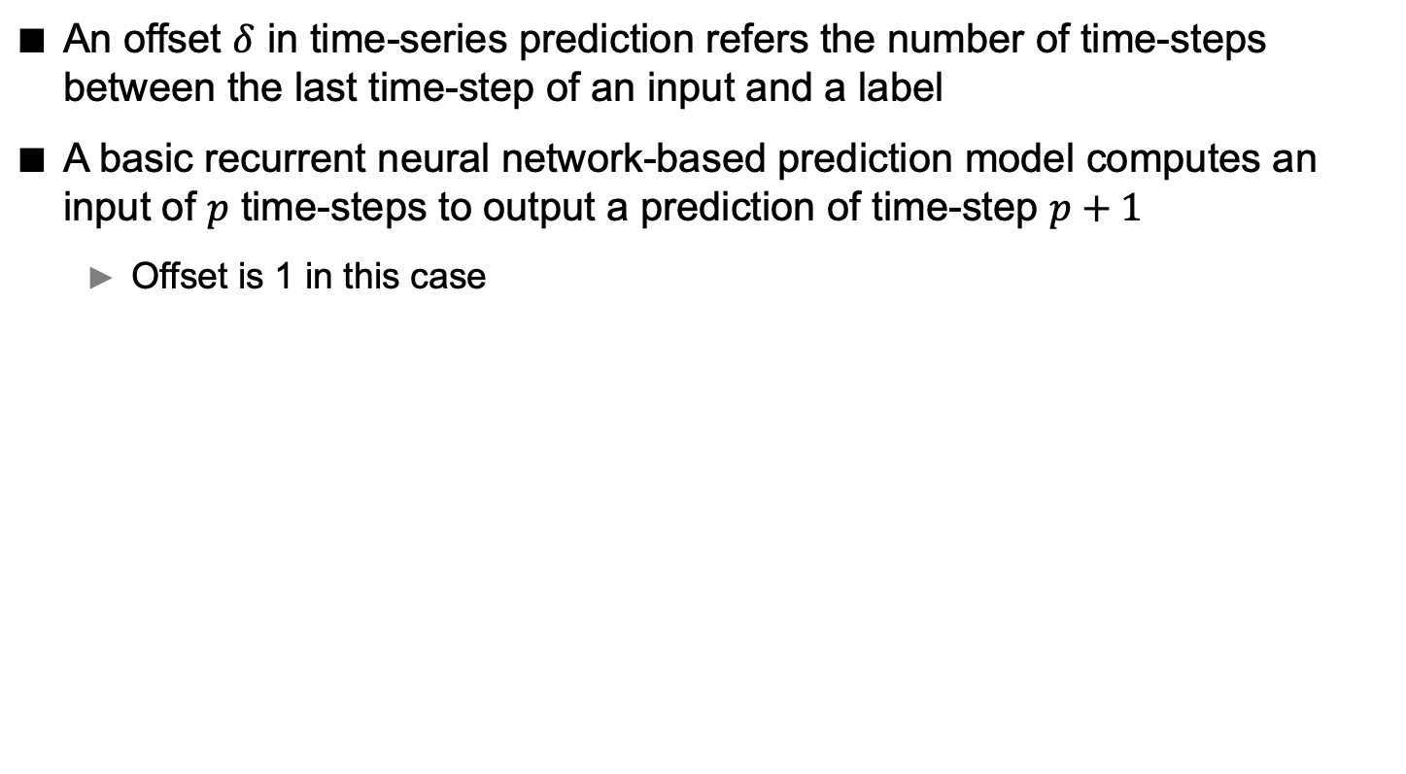
Model Architecture (2/3)
An offset $δ$ in time-series prediction refers the number of time-steps between the last time-step of an input and a label
A basic recurrent neural network-based prediction model computes an input of $p$ time-steps to output a prediction of time-step $p+1$
Offset is 1 in this case
Offset 1
Offset 2
$$S_{1}$$ | $$S_{2}$$ | $$S_{3}$$ | $$S_{4}$$ | $$S_{5}$$
Input
Output
<Example: 5 time-steps of sequence where time-steps of input and output is 3 and 2, respectively>

Slide 10
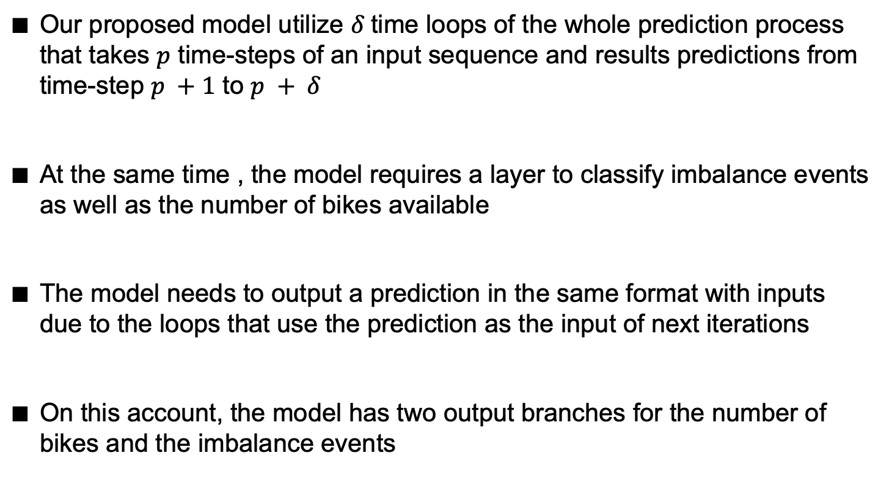
Model Architecture (3/3)
Our proposed model utilize $δ$time loops of the whole prediction process that takes $p$ time-steps of an input sequence and results predictions from time-step $p +1$ to $p + δ$
At the same time , the model requires a layer to classify imbalance events as well as the number of bikes available
The model needs to output a prediction in the same format with inputs due to the loops that use the prediction as the input of next iterations
On this account, the model has two output branches for the number of bikes and the imbalance events

Slide 11
Dataset (1/2)
Bike sharing datasets from the related papers contain only bike rental and return location of user trips
New York, Washington DC, Singapore, and Taipei
Chicago city bike dataset has abundant information among above datasets
User trips: rental station, return station, time
Bike Routes: GPS information of common traveling routes
Historical bike stations: station, capacity, utilization of bike docks

Slide 12
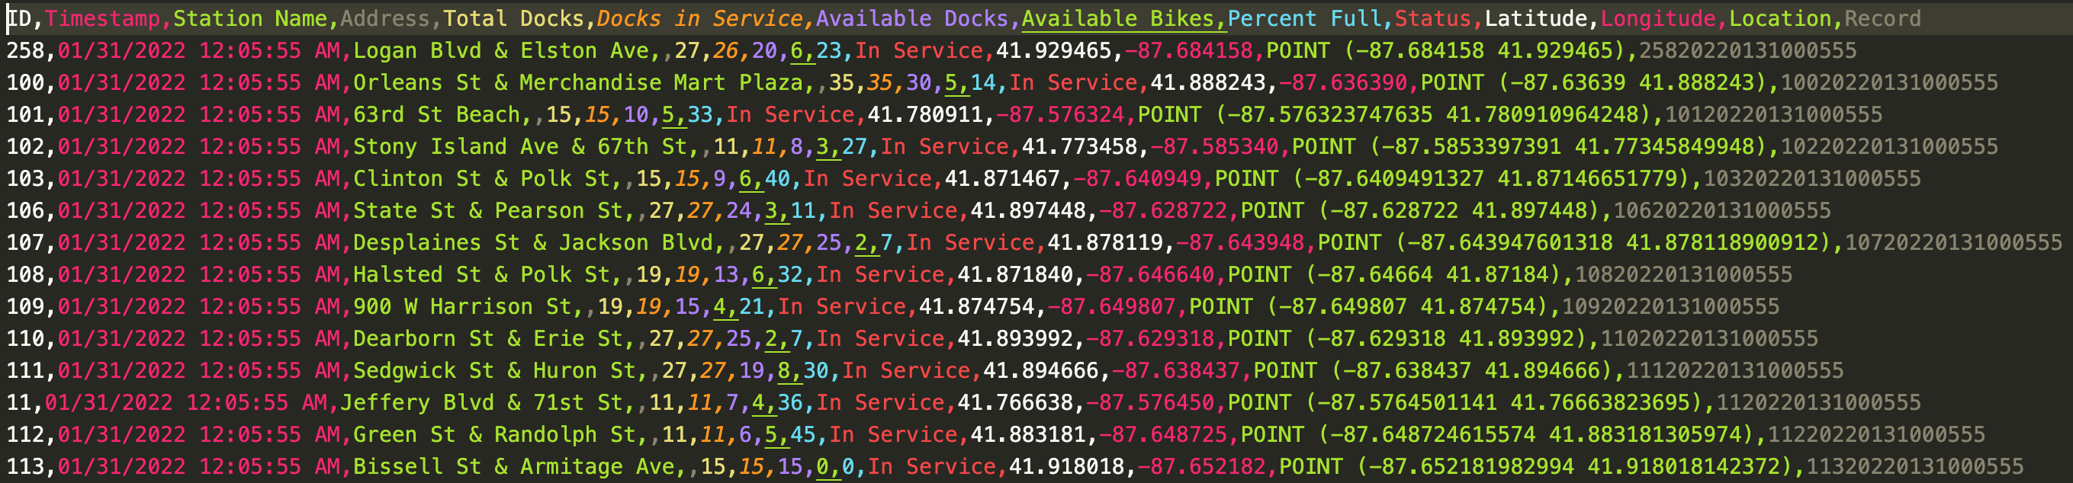
Dataset (2/2)
Chicago historical bike stations dataset
3,451,068 rows for 1 month
611 stations
Dock utilization status (i.e., bike availability) is logged at every 1 hour

Slide 13
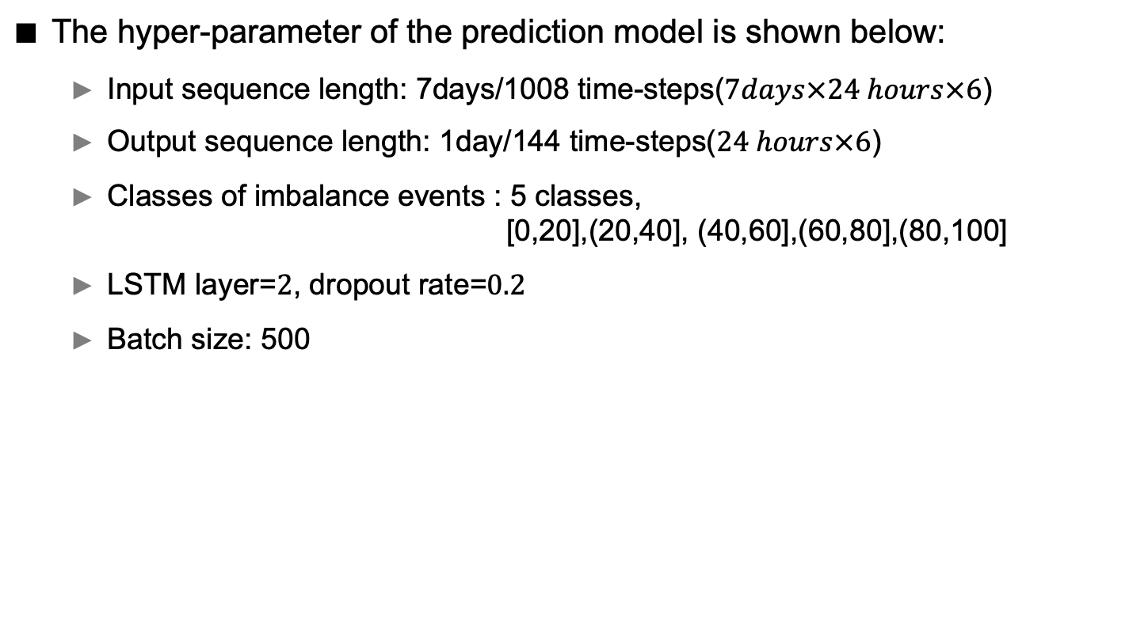
Experimental Results (1/3)
The hyper-parameter of the prediction model is shown below:
Input sequence length: 7days/1008 time-steps($7days×24 hours×6$)
Output sequence length: 1day/144 time-steps($24 hours×6$)
Classes of imbalance events : 5 classes, [0,20],(20,40], (40,60],(60,80],(80,100]
LSTM layer=$2$, dropout rate=$0.2$
Batch size: 500

Slide 14
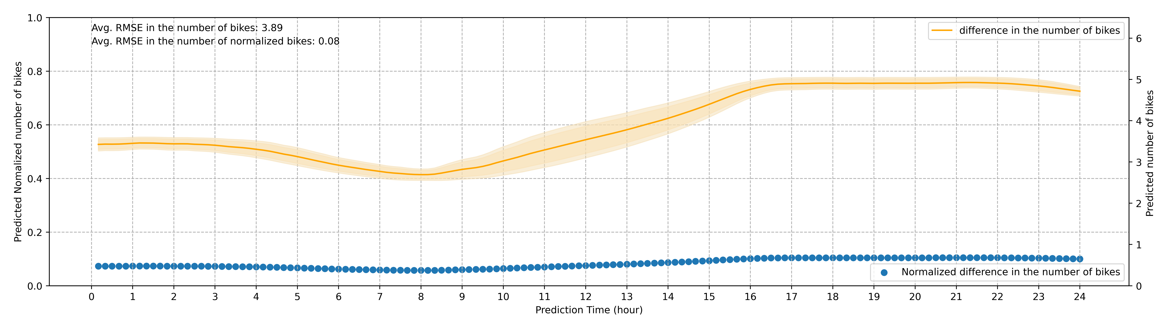
Experimental Results (2/3)
The RMSE in the number of bikes and normalized RMSE
CI 99% and 95% are depicted
Prediction error in 3.89 bikes

Slide 15
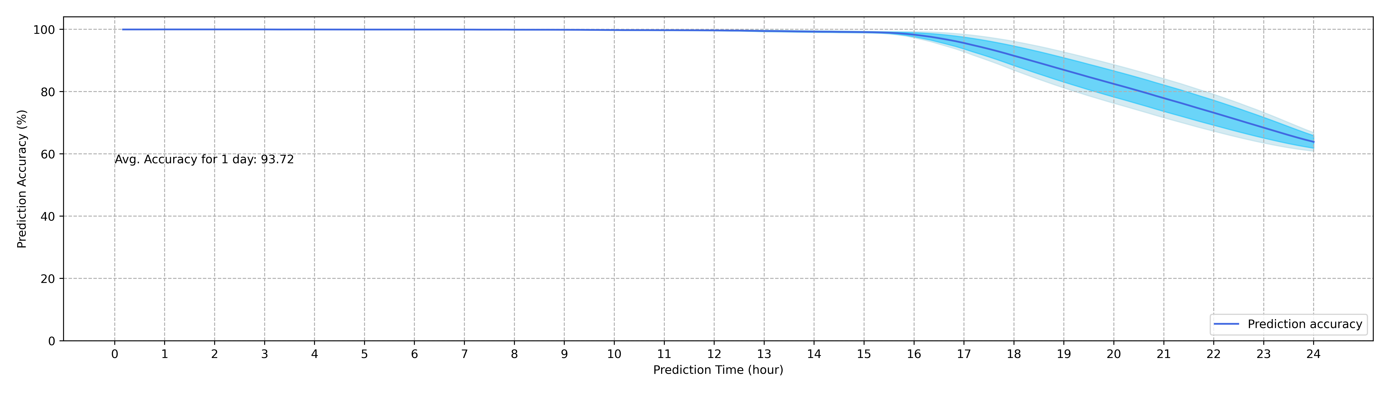
Experimental Results (3/3)
The accuracy performance of the model
CI 99% and 95% are depicted
93.72% prediction accuracy

Slide 16
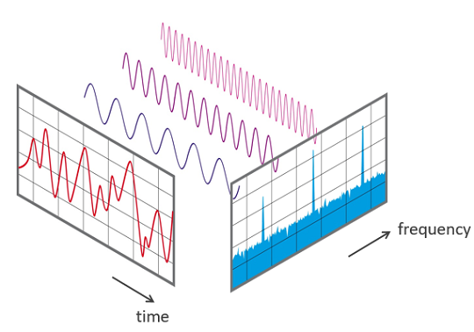
Advanced Model (1/4)
The various perspective of input data can improve model performance
Fast Fourier Transformation converts signal sequences in time domain into frequency domain, and the frequency values can be used as feature vector of the input data
<Fast Fourier Transformation>

Slide 17
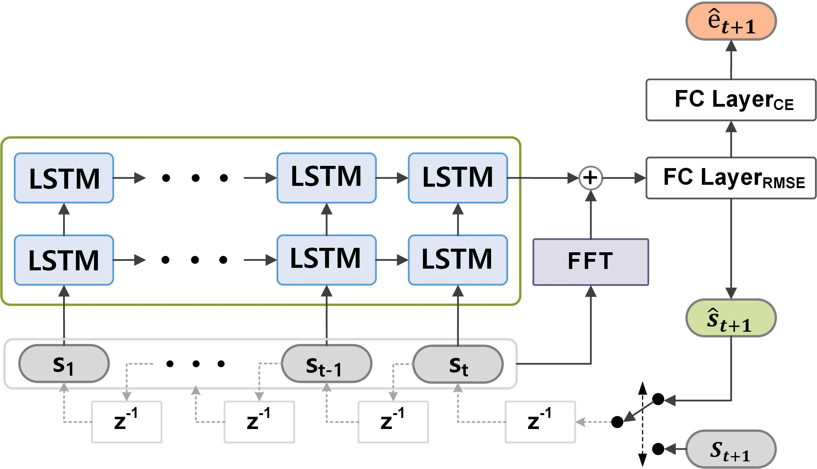
Advanced Model (2/4)
The model can extract additional feature through FFT
The result of FFT is converted into feature vector and concatenated with latent vector from LSTM layers

Slide 18
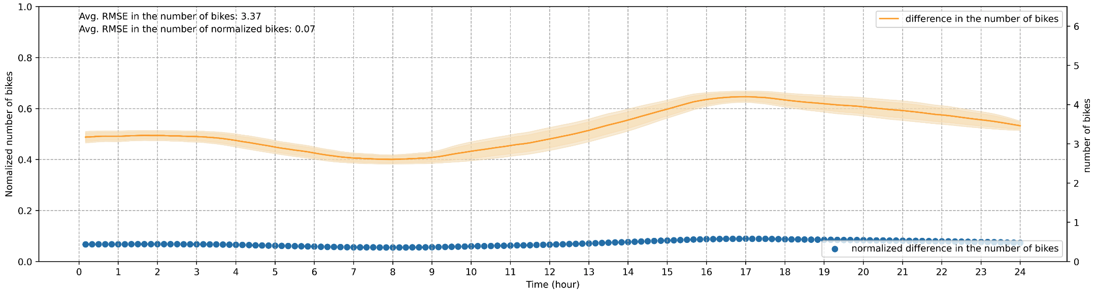
Advanced Model (3/4)
The RMSE in the number of bikes and normalized RMSE
CI 99% and 95% are depicted
Prediction error in 3.37 bikes

Slide 19
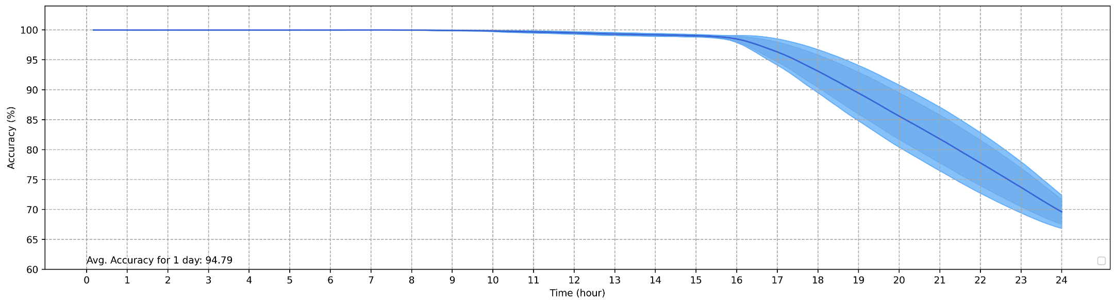
Advanced Model (4/4)
The accuracy performance of the model
CI 99% and 95% are depicted
94.79% prediction accuracy

Slide 20
Future Work
Content for papers
Content | IMCOM2023(Short Paper) | Journal Paper
Model | Implementation of offset Two output branches (e.g., RMSE and CE) and their joint training | Implementation of FFT Implementation of weight configuration between two loss functions (RMSE and CE)
Plotting | Prediction Accuracy RMSE (bike numbers) | Analyses based on stations Geographical visualization Accuracy comparison with various models
- | More effort on model implementation | Upgrade model, and put effort on analyses and visualization

